Slide 1
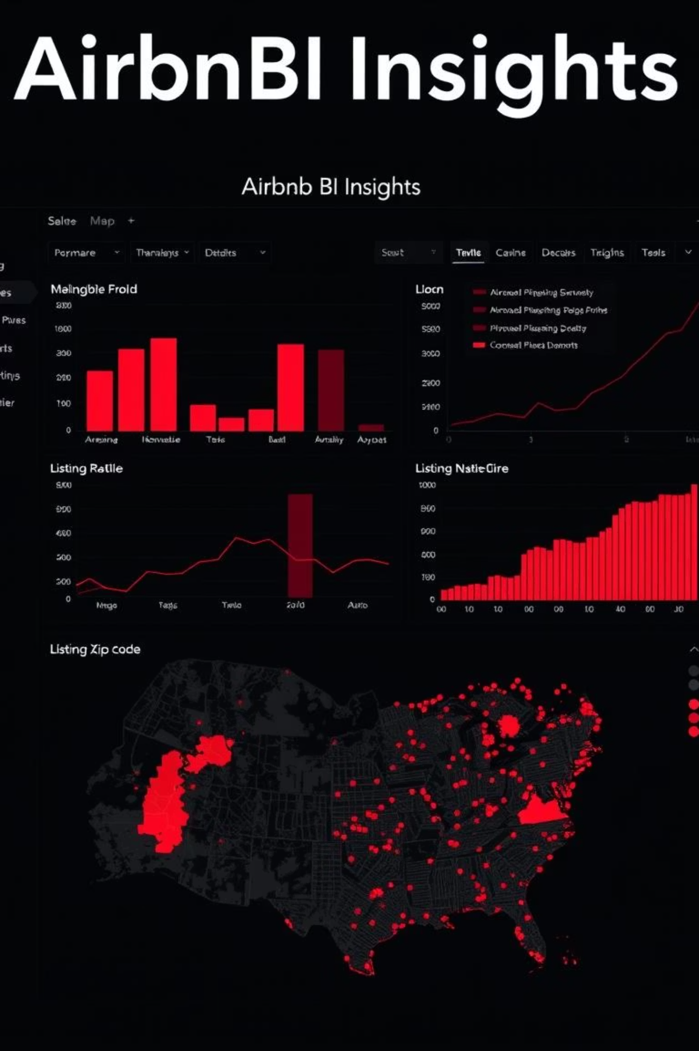
Airbnb Listings Analysis Dashboard
Power BI Project by Arya Bhor

Slide 2
Title Slide
Title
Subtitle
Author Name
Airbnb Listings Analysis Dashboard
A Data-Driven Exploration of Airbnb Performance
Arya Bhor
Tools Used
Date
Power BI, Excel
June 2025

Slide 3


Objective
Analyze Airbnb listings to understand pricing, availability, host behavior, and customer engagement.
Identify trends in room types, neighborhood demand, and review patterns.
Help stakeholders optimize pricing, room types, and availability strategies.

Slide 4
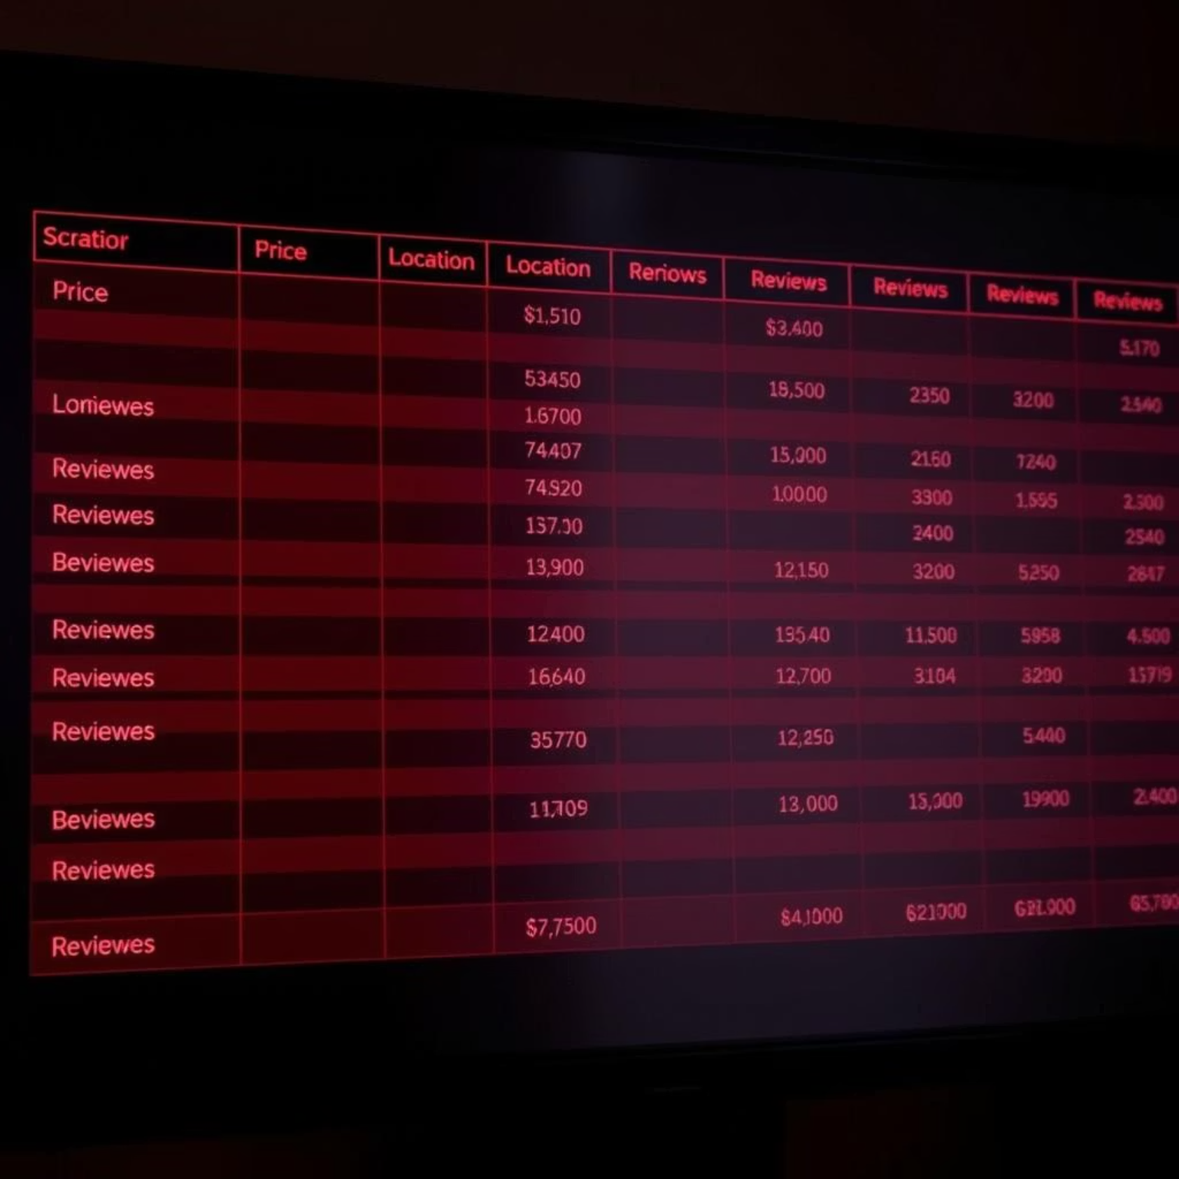
Dataset Overview
Columns Used
id, name, host_id, host_name
neighbourhood_group, neighbourhood
latitude, longitude
room_type, price, minimum_nights
number_of_reviews, last_review, reviews_per_month
calculated_host_listings_count, availability_365
Data includes host details, location, room types, pricing, and availability.

Slide 5
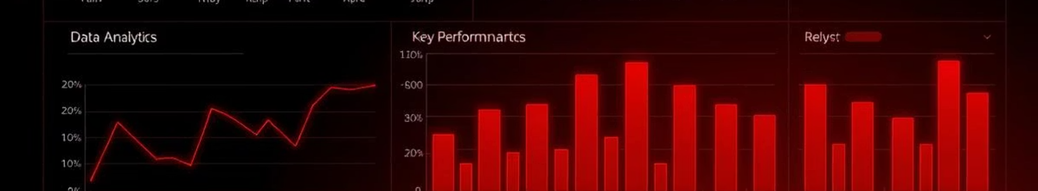
Key KPIs
37.4K
221
2M
935
Total Hosts
Neighbourhoods Covered
Total Reviews
Average Reviews per Month
🧑‍💼
💬
📍
📈

Slide 6
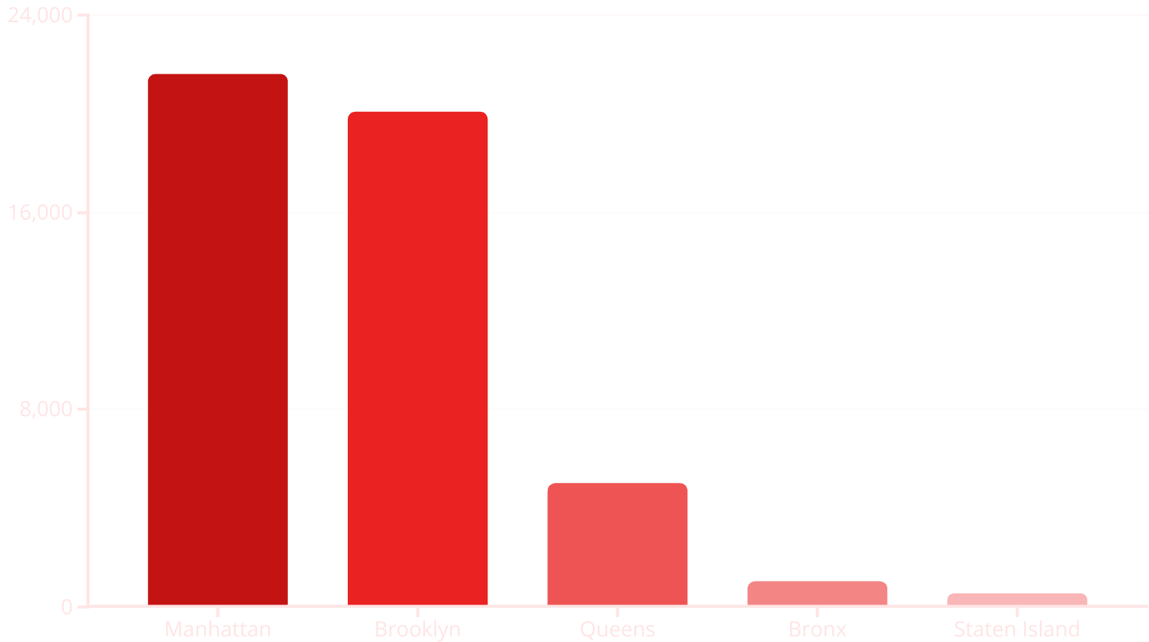
Neighbourhood Group Performance
Manhattan has the highest number of bookings (21.6K)
Brooklyn follows closely with 20.1K
Queens, Bronx, and Staten Island have fewer listings/bookings

Slide 7
Room Type Pricing by Location
Entire Homes/Apartments are most expensive in Manhattan ($249)
Room Type
Location
Average Price
Private Rooms and Shared Rooms are most affordable in Bronx ($67 & $60)
Entire Home/Apartment
Manhattan
$249
Brooklyn and Queens offer mid-range options
Private Room
Bronx
$67
Shared Room
Bronx
$60
Entire Home/Apartment
Brooklyn
$180
Entire Home/Apartment
Queens
$150

Slide 8
Top Expensive Neighborhoods
1
Fort Wadsworth
$800 avg price
2
Woodrow
$700
3
Tribeca
$490
4
Sea Gate
$450
5
Riverdale
$400
6
Battery Park
$380

Slide 9
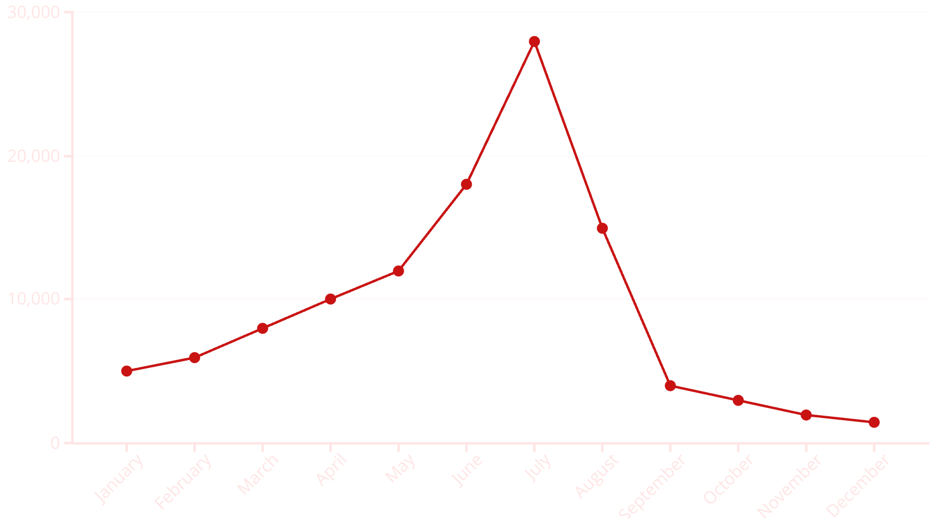
Review Trends by Time
Review activity peaks in July (28K) and August (15K)
Very low activity from September to December
Suggests strong seasonality in booking trends

Slide 10





Host Analysis
Maya
2.3K reviews
BrooklynArtsy
2.2K reviews
Danielle
High review count
Yasu & Jun
High review count
High review counts suggest strong reputation or multiple listings

Slide 11
